Slide 1

Job Hunt Mobile Application
Discover what is possible.
Realize, Focus & Achieve
Group -6

Slide 2


“Presented by”
No | Student Name | Student ID
1 | Mayurkumar Patel | 2091270
2 | Meet Patel | 2091085
3 | Abhishek Kathuria | 2091103
4 | Shiva Praneeth Pabathi | 2091461
5 | Sruthi Podupati | 1995568
“Under the Guidance of”
Prof.Reza Madadi
Prof.Sakshi Sharma
Prof.Sliviya Paskelava

Slide 3


Slide 4

Why this app ?
The most important invention with the developing advancements in Technology.
To create a virtual platform for job finders as well as for the employers.
Because of increasing level of education amongst the students.
Creating opportunities for all.
This will help employers to find skilled workers and knowledgeable people beyond their imagination.

Slide 5

In the implementation of this application

Slide 6

How did we decide which features to include ?
We want to keep the App Simple
Idea in general
Speed
Security
Color
Reviewing existing applications in the Store
User friendly
We generated different ideas such as
List of jobs, job details, applying for a particular job, adding a new job, date picker and user profile.

Slide 7
How did we choose which technologies to use?
Firebase Firestore
Firebase Storage reference
Java (Back end)
XML(extensible markup language)(frontend)
Lets You Easily Store , sync and query data for your mobile apps
Structure our data easily with collections and documents

Slide 8
Team Work.
We want to see our whole team winning.

Slide 9
When it came to working together and to cope-up with the challenges, we divided tasks equally with the approval of each team member.
For the documentation part Sruthi Podupati has advised whole team in which direction everyone should work
For the coding part Mayurkumar patel and Shiva Praneeth Pabhathi has Guided the whole team how to plan and code the features.
While Meet Patel and Abhishek Kathuria has more exposure about designing UI so they instruct everyone how to design widgets properly and which layout will be appropriate and where.
The User login,Job details(Dashboard),Saved Jobs, View Applicants, header layout,user activity, view User List is done by Meet Patel.
View Added Jobs,Add new job post,Admin activity, Admin login,Alert Dialog box, Nav graph login, nav graph admin is done by Abhishek Kathuria.
Signup,Splash,Add new job post,Update profile,View details of applicants, Login activity, View job post,Delete user post is by Sruthi Podupati.
Forgot password, User drawer menu, admin drawer menu,Search bar(Admin), Accept / Decline Applicants, View Status of Applied post,Verify user post,Navigation graph user is done by Shiva Praneeth Pabhathi.
Search bar(User), View Applied Jobs, User persona, Update Profile,Apply Job, Status of Job post, Verify user post, French language translation is done by Mayur Patel.

Slide 10
Covid affects our working pattern
As we are all aware that pandemic has changed our life from normal to new normal.
To keep the whole team safe, we had the only option of working from home.
Although, it felt very uncomfortable, we took help of several application like Any desk, Teamviewer to view and control each other PCs remotely.
For virtual team meetings after each week, we used ZOOM application whereas Google platform for sharing documents and important project notes.

Slide 11

Features of this Application

Slide 12
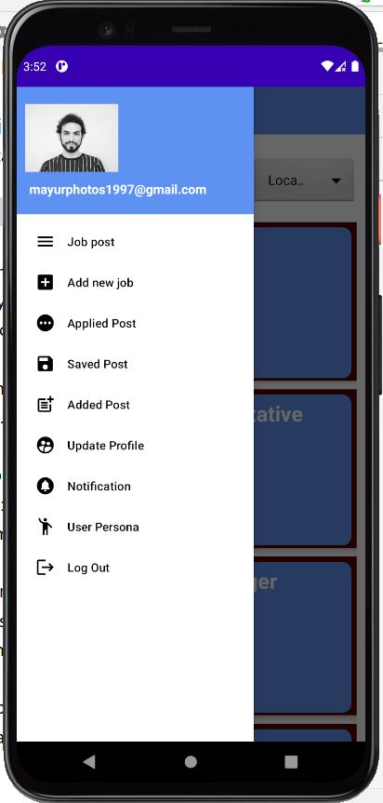
User side features :
This app provides 9 different menu options with different purposes on User side.
The JOB POST menu option can be used to see list of jobs posted by others. Other than that a user can see the details of the jobs as well by clicking on its title.
The Add New Job provides facility that user can add the job post for recruitment. However it will be reflected directly to the list of jobs, after being screened and approved by the admin.
The APPLIED POST allows user to see the list of job he has applied. Similarly, SAVED POST and ADDED POST does the same job of showing saved jobs and added jobs by user respectively.

Slide 13
:
User side features :
This app provides 9 different menu options with different purposes on User side.
The update profile allows user to add personal information as well as the profile picture and resume file.
However, the notification feature notify user whenever any job post gets approved by admin and any job application gets approved or disapproved.
Talking about User persona, it allows user to access personal information as well as resume file.

Slide 14
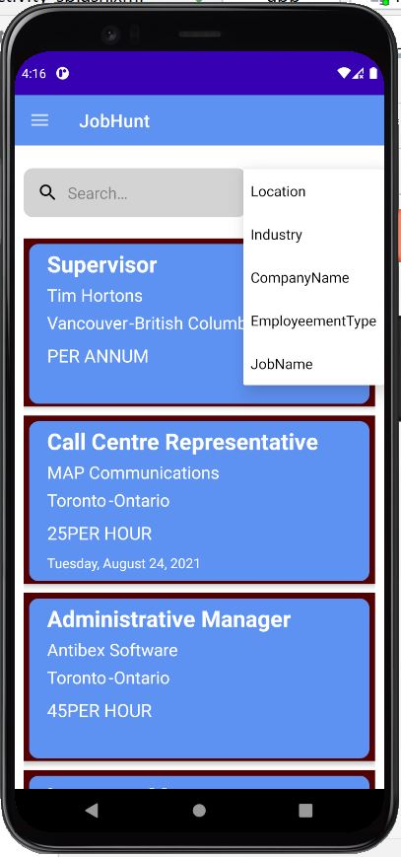
User side features :
Search Option:
On the Dashboard of User side there is one search box provide, which allows user to search a job by specific location, industry , company name, employment type and job name/Job title.
While discussing about this feature we thought this will be difficult for implementation, But beyond our imagination we did this without any logical bug.

Slide 15
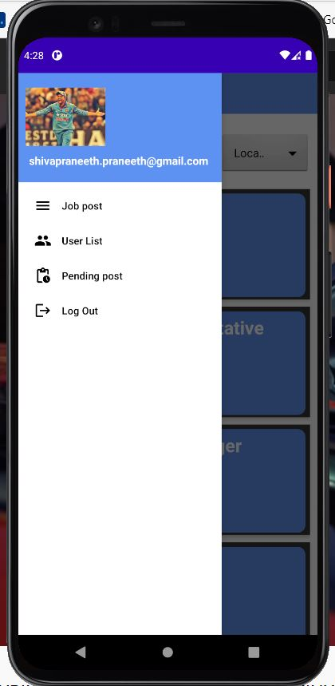
Admin side features :
This app provides four different menu options on admin side:
The Job Post basically does the same job as it does on the user side of showing job list, so the admin can see the jobs and if it does not seem appropriate than the admin can delete it as well.
However, the user list shows the list of user accounts on the database.
As discussed before, whenever user post anything It can only be reflected on the job list activity if admin approves it. So, Pending post has that functionality, where admin can approve or disapprove the job post.

Slide 16
How did we overcome git conflicts ?
As we are using only one branch which was our master branch.
Revert Commit.
Pull Conflict
Push Conflict

Slide 17
Conclusion:
To make this possible, the whole team made a lot of efforts and allocation of time specific for advance features. We whole team thanking each team member for their efforts.
How can we forget ?, it was not possible without guidance of our teachers. Thank you Prof. Reza Madabadi , Prof. Sakshi Sharma & Prof. Sliviya Paskelava for guiding us in the right direction.

Slide 18



Thank You
Mayurkumar Patel - 2091270
Shiva Praneeth Pabathi - 2091461
Meet Patel - 2091085
Sruthi Podupati - 1995568
Abhishek Kathuria - 2091103

